Slide 1
Programación de Dispositivos de Red
Serges Nanfack
Technical Manager , Field Engagement - SSA
2 de Marzo del 2016

Slide 2
Índice de la presentación
¿Qué es la Programación de Dispositivos de Red?
Arquitectura SDN
OpenFlow
Infraestructura Cisco Application Centric

Slide 3
¿Qué es la Programación de Dispositivos de Red?

Slide 4

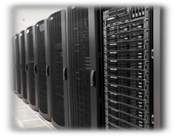





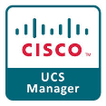

Evolución de la Configuración de Servidores
En los noventa
Actualmente
+
+
o
3
Notes:
Why we are talking about SDN? Lets reflect for a minute on why and how we got to where we are. Lets take the data center as an example”. In the 90’s the way we used to install servers was by using CD. Because of the emerging of the cloud, the Data Center had to adopt fast and that’s why the data center has moved to a more automated way of building servers by leveraging automation tools like chef, puppet, openstack and UCS Manager

Slide 5
Modelo IT Actual –
Complejo, No Suficientemente Rápido
Equipo por Equipo Configuración Manual
Notes:
If you look at the main issue in today’s network, is the inability to configure certain features in an automated way. This problem translates to an OPEX where we have to go box per box to provision anything and just about everything. The network is too big to do this anymore”.

Slide 6
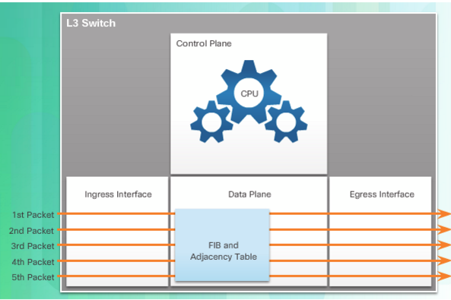
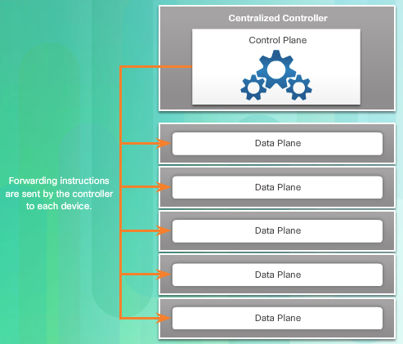
Virtualización de Red
Modelo Tradicional
Modelo Virtualizado
3
Notes:
Over a decade ago, VMware developed a virtualizing technology that enabled a host OS to support one or more client OSs. Most virtualization technologies are now based on this technology. The transformation of dedicated servers to virtualized servers has been embraced and is rapidly being implemented in data center and enterprise networks.
CEF is an advanced, Layer 3 IP switching technology that enables forwarding of packets to occur at the data plane without consulting the control plane. In CEF, the control plane’s routing table pre-populates the CEF Forwarding Information Base (FIB) table in the data plane.
To virtualize the network, the control plane function is removed from each device and is performed by a centralized controller, as shown in Figure 2. The centralized controller communicates control plane functions to each device. Each device can now focus on forwarding data while the centralized controller manages data flow, increases security, and provides other services.

Slide 7


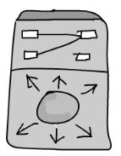
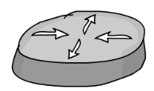
Una Aproximación Clásica a SDN
Control Plane
Dónde/Cómo se envían paquetes
Data plane
Envío de Paquetes
Controlador
NETops/
DEVops
“…En una arquitectura SDN, los planos de control y de datos están desacoplados, la inteligencia y el estado de la red están centralizados de forma lógica, y la infraestructura de red subyacente se deduce de las aplicaciones …”
Control Plane
Fuente: www.opennetworking.org
Control Plane
Data plane
Data plane
Notes:
Looking an SDN from a purist point of views.
This is the basic principle of SDN.
A network device has a control plane and a data plane.
The data plane forwards the packets.
The control plane tells the device how and where to forward the packets.
In classical SDN the control and data place are decoupled. The control plane is moved off the individual network devices to a controller.
A controller is central point of management, policy and visibility.
The benefit of this approach is that you now can define policy, configure devices, have visibility from a single point.
This fundamentally changes operations and simplifies things. It also opens up a lot of opportunity to do things different.
There are drawbacks though with this architecture.
Performance, scalability and availability for starters.

Slide 8
La aproximación de Cisco: ACI – Application Centric Infrastructure
Control Plane
Dónde/Cómo se envían paquetes
Data plane
Envío de paquetes
Controlador
Control Plane
Evolución que NO
Control Plane
REVOLUCIÓN
NETops/
DEVops
EVOLUCIONAR PARA RESPONDER A NUEVOS REQUERIMIENTOS
Simplicidad Operacional
Programable
Adaptable a las Aplicaciones
Control Plane
MANTENER AQUELLO QUE FUNCIONA
Resiliencia
Escalabilidad y Seguridad
Amplio Conjunto de Prestaciones
Control Plane
Data plane
Data plane
Notes:
The Cisco approach to the best of both worlds.
Keep what works well but evolve for new requirements.
Allow your existing network investment to be programmable.
Allow you existing network investment to be defined by a controller

Slide 9
Arquitectura SDN

Slide 10
Arquitectura de Red Tradicional
Control Plane
Data Plane
Arquitectura de Red con SDN
IOS
Hardware
Notes:
In a traditional router or switch architecture, the control plane and data plane functions occur in the same device. Routing decisions and packet forwarding are the responsibility of the device operating system.
Software defined networking (SDN) is a network architecture that has been developed to virtualize the network. For example, SDN can virtualize the control plane. Also known as controller-based SDN, SDN moves the control plane from each network device to a central network intelligence and policy-making entity called the SDN controller.
The SDN controller is a logical entity that enables network administrators to manage and dictate how the data plane of virtual switches and routers should handle network traffic. It orchestrates, mediates, and facilitates communication between applications and network elements.

Slide 11
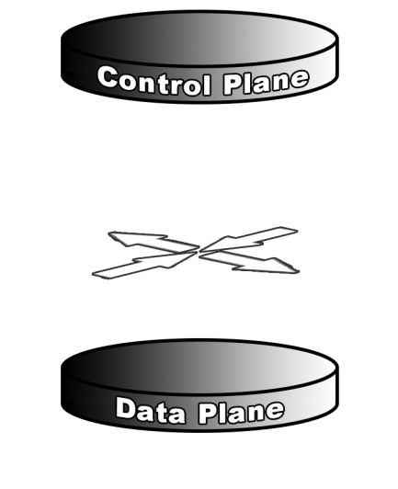
En otras palabras …
Con el paradigma SDN, no todo el procesamiento se lleva a cabo en el mismo dispositivo

Slide 12
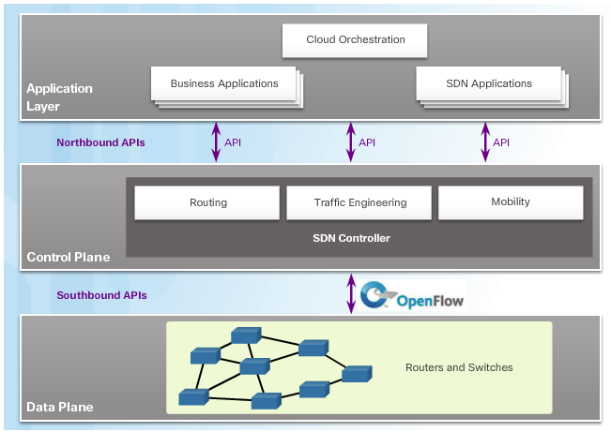
Infraestructura SDN
API Ascendente
API Descendente
3
Notes:
Note the use of Application Programming Interfaces (APIs) within the SDN framework. An API is a set of standardized requests that define the proper way for an application to request services from another application.
Northbound APIs to communicate with the upstream applications. These APIs help network administrators shape traffic and deploy services.
Southbound APIs to define the behavior of the downstream virtual switches and routers. OpenFlow is the original and widely implemented southbound API
The Open Networking Foundation is responsible for maintaining the OpenFlow standard

Slide 13

¿Qué es Openflow?
OpenFlow es un protocolo de comunicación que da acceso a la capa de re-envío de un conmutador de red o encaminador a través de la red
Notes:
The SDN controller defines the data flows that occur in the SDN Data Plane. A flow is a sequence of packets traversing a network that share a set of header field values. For example, a flow could consist of all packets with the same source and destination IP addresses, or all packets with the same VLAN identifier.
Each flow through the network must first get permission from the SDN controller, which verifies that the communication is permissible according to the network policy. If the controller allows a flow, it computes a route for the flow to take and adds an entry for that flow in each of the switches along the path.

Slide 14
Los cuatro componentes de Openflow
App
Controlador de Openflow
API Ascendente
Agente de Dispositivo Openflow
Protocolo Openflow
App
App
Openflow
Protocol
Northbound API
Openflow Controller Code
OF
AGENT
SERVER
OF
AGENT
OF
AGENT
Notes:
Comments about it’s a interface not SDN
The controller is the central part. Aggregates info from everywhere and makes the decisions. From here, the devices are sent instructions.
Northbound API is exposing the controller to programmers who want to perform specialized and non-specialized functions.
Device agent sits on the local devices. Listens to the controller and interprets the instructions
Openflow protocol is the protocol that interacts between all devices and the controller.

Slide 15
Controlador Openflow
Punto Central de Administración y Operaciones para los Elementos de Red
Openflow Controller Code
SERVER

Slide 16
Controlador Openflow | API Ascendente
App
API Ascendente como parte Integral del Controlador
Las aplicaciones “enfocadas a red” pueden utilizar la API Ascendente para solicitar servicios de la red …
App
App
Northbound API
SERVER

Slide 17
Agente de Dispositivo de Openflow
El Agente se ejecuta en el dispositivo de red
El Agente recibe instrucciones del Controlador
El Agente gestiona las tablas del dispositivo (capa de re-envío)
OF
AGENT
SERVER
OF
AGENT
OF
AGENT

Slide 18
Protocolo Openflow
El Protocolo Openflow es…
“Un mecanismo que permite al Controlador Openflow comunicarse con los Agentes Openflow de los dispositivos…”
SERVER

Slide 19
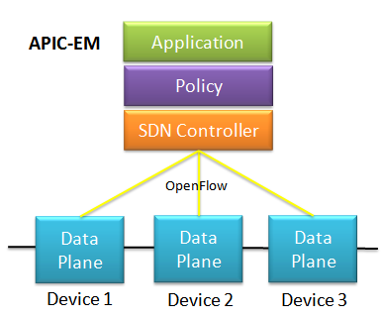
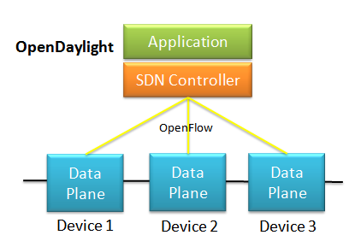
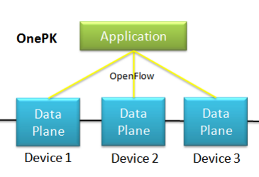
Tipos de SDN
SDN basadas en Dispositivos
SDN basadas en Controlador
SDN basadas en Políticas
Easy QoS
Follow Me QoS
Compliance Assurance
Automated Performance Routing (PfR) Configuration
Automated WAN Policy Compliance Assurance
Habilitando Virtualización de Redes
Notes:
Device-based SDN
In this type of SDN, the devices are programmable by applications running on the device itself or on a server in the network, as shown in Figure 1. Cisco OnePK is an example of a device-based SDN. It enables programmers to build applications using C, and Java with Python, to integrate and interact with Cisco devices.
This type of SDN uses a centralized controller that has knowledge of all devices in the network, as shown in Figure 2. The applications can interface with the controller responsible for managing devices and manipulating traffic flows throughout the network. The Cisco Open SDN Controller is a commercial distribution of OpenDaylight.
This type of SDN is similar to controller-based SDN where a centralized controller has a view of all devices in the network, as shown in Figure 3. Policy-based SDN includes an additional Policy layer that operates at a higher level of abstraction. It uses built-in applications that automate advanced configuration tasks via a guided workflow and user-friendly GUI with no programming skills required. Cisco APIC-EM is an example of this type of SDN.

Slide 20
Arquitectura Cisco Application Centric
Notes:
Very few organizations actually have the desire or skill to program the network using SDN tools. However, the majority of organizations want to automate the network, accelerate application deployments, and align their IT infrastructures to better meet business requirements. Cisco developed the Application Centric Infrastructure (ACI) to meet these objectives in more advanced and innovative ways than earlier SDN approaches.

Slide 21
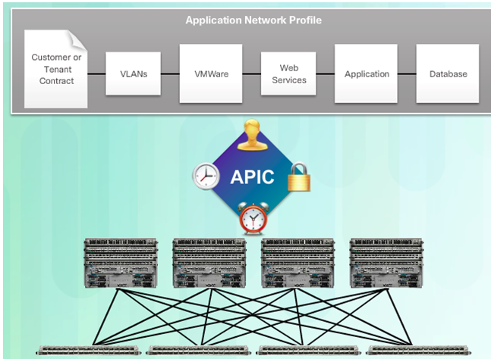
Componentes Importantes de Cisco ACI
Perfil de Aplicaciones de Red (Capa ANP):
Biblioteca de todas las políticas en la Red
APIC
(Application Policy Infraestructure Controller) :
como punto central de la arquitectura ACI
Cisco Nexus 9000 Series Switches
3
Notes:
Application Network Profile (ANP) - An ANP is a collection of end-point groups (EPG), their connections, and the policies that define those connections. The EPGs shown in Figure 1, such as VLANs, Web Services, and Applications, are just examples. An ANP is often much more complex.
Application Policy Infrastructure Controller (APIC) – The APIC is considered to be the brains of the ACI architecture. APIC is a centralized software controller that manages and operates a scalable ACI clustered fabric. It is designed for programmability and centralized management. It translates application policies into network programming.
Cisco Nexus 9000 Series switches – These switches provide an application-aware switching fabric and work with an APIC to manage the virtual and physical network infrastructure.

Slide 22
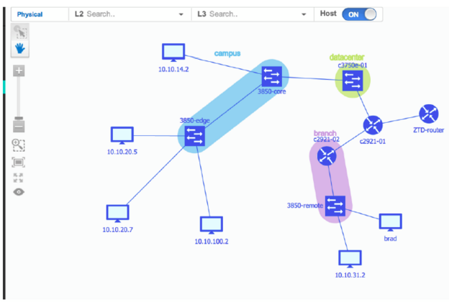
APIC – características EM
Descubrimiento
Inventariado de Dispositivos
Inventariado de Hosts
Topología
Políticas
Análisis de Políticas
3
Notes:
Discovery - Supports a discovery functionality that is used to populate the controller's device and host inventory database.
Device Inventory - Collects detailed information from devices within the network including device name, device status, MAC address, IPv4/IPv6 addresses, IOS/Firmware, platform, up time, and configuration.
Host Inventory - Collects detailed information from hosts with the network including host name, user ID, MAC address, IPv4/IPv6 addresses, and network attachment point.
Topology - Supports a graphical view of the network (topology view). The Cisco APIC-EM automatically discovers and maps devices to a physical topology with detailed device level data. In addition, auto-visualization of Layer 2 and 3 topologies on top of the physical topology provides a granular view for design planning and simplified troubleshooting. Figure 1 shows an example of a topology view generated by the Cisco APIC-EM.
Policy - Ability to view and control policies across the entire network including QoS.
Policy Analysis - Inspection and analysis of network access control policies. Ability to trace application specific paths between end devices to quickly identify ACLs in use and problem areas. Enables ACL change management with easy identification of redundancy, conflicts and incorrect ordering of access control entries. Incorrect ACL entries are known as shadows.

Slide 23

Cisco APIC - Enterprise Module:
Escenarios de Despliegue Inicial
QoS
Automatización de Seguridad
Provisionamiento de QoS
IWAN: Optimización de Rutas
Detección y Mitigación de Amenazas Rápida en toda la Red (sourcefire)
Easy QoS
Follow Me QoS
Garantías de Cumplimiento
Configuración de Enrutamiento de Rendimiento Automatizado (PIR)
Garantías de Cumplimiento de Políticas WAN Automatizadas
Solución de los Más Exigentes, Complejos y Tediosos Problemas IT
Notes:
Security Automation:
Compliance
Shadow Identification
Conflict Identification
Compliance Assurance
Troubleshooting
Flow-Based
Trace and Compare
Mobility
Follow me ACL
QoS Provision
Easy QoS
CVD or IT template Based QoS
Compliance Assurance
Follow me QoS
IWAN: Path Optimization

Slide 24
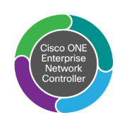



Cisco APIC - EM: Detección y Mitigación Automática de Amenazas Despliegue Rápido de Seguridad en Toda la Red
Cisco APIC Enterprise Module
ACCIÓN DE REMEDIO
ACTUALIZACIÓN
Cisco APIC - Enterprise Module
Centro de Defensa
AMENAZA DETECTADA
Notes:
Malware/Javascript Infection from Internet
SF Sensor detects threat
SF DC notifies Controller
Remediation API event
Policy installed on Access switch port by Controller.
Block or quarantine end-point (host A)

Slide 25
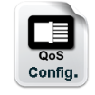
Resumen de Caso de Uso de QoS
QoS
Easy QoS
Garantía de Cumplimiento
Follow-Me QoS
CVD* o Política QoS basada en Plantillas IT
Flag para activar Políticas
QoS Automatizada para Usuarios en Mobilidad
* CVD – Cisco Validated Design

Slide 26







Cisco APIC Enterprise Module: Easy QoS Automatización de la Gestión QoS
QoS
Cisco APIC Enterprise Module
Plantillas Basadas en Cisco Validated Design
Cisco APIC Enterprise Module
Config.

Slide 27
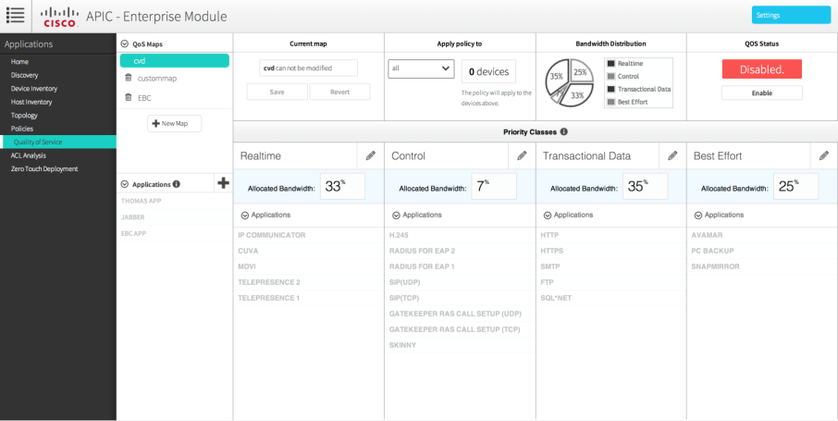
Cisco APIC – EM : Provisionamiento de QoS Automatización de la Gestión de QoS
QoS
Notes:
Enables system level QoS classification, marking and queuing policies
Uses Cisco valid design (CVD) templates to ensure faster, more reliable, and fully predictable deployment
Supports custom classification templates to meet enterprise specific needs

Slide 28
Cisco APIC Enterprise Module: Cumplimiento de QoS Automatización de la Gestión de QoS
QoS
Cisco APIC Enterprise Module
Comprobación Automática del Cumplimiento de QoS
Cisco APIC Enterprise Module
Config.
Cambios de Configuración

Slide 29

Cisco APIC Enterprise Module: Follow-Me QoS Automatización de la Gestión de QoS
QoS
Actualización…
Cisco APIC Enterprise Module
Actualizado
Cisco APIC Enterprise Module
Config.
Cisco Prime
Actualizado

Slide 30
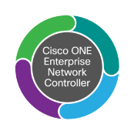
Cisco on Cisco: Desplegando Video Jabber HD en todo Cisco
Tarea IT:
Actualizar la Configuración del Clasificador QoS en todos los Dispositivos Frontera de Cisco
75,000 Empleados,160 Localizaciones Globales
7,000 Conmutadores y 29,000 Encaminadores
QoS
Anteriormente: Semanas
5-7 Líneas de Configuración Manual en cada uno de los Dispositivos Frontera
Configuración Manual Personalizada para cada Tipo y Modelo de Dispositivo
Script A medida para el Escalado
Comprobación Manual de Cumplimiento con periodicidad Trimestral
Después: Horas
Configuración Automatizada para cada uno de los Dispositivos Frontera
Configuración Automatizada Personalizada para cada Tipo y Modelo de Dispositivo
Tan sólo un Click, para el escalado
Comprobación Automatizada de Cumplimiento en Cualquier Momento de Forma Inmediata
Cisco APIC - Enterprise Module
Notes:
Jabber: Collaborate Anywhere on Any Device

Slide 31
Páginas de Interés
www.opennetworking.org
www.openstack.org
Cisco application policy interface controller (apic)

Slide 32
Gracias

